Slide 1

TEAM 'ALL OUT'
PRESENTS

Slide 2
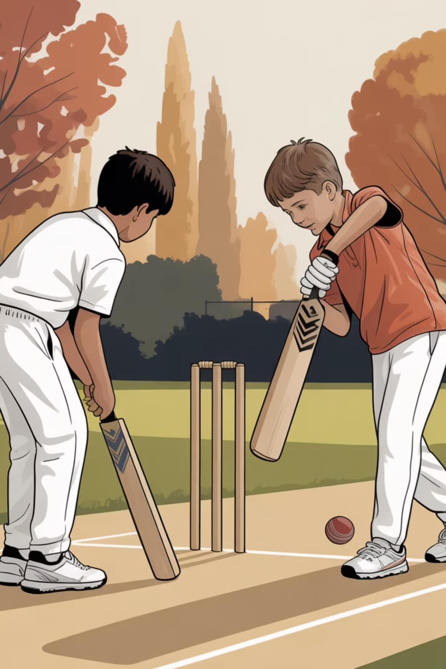
Hand Cricket Game Using C
A simulation of the classic Hand Cricket game, demonstrating fundamental C programming concepts including random number generation, conditional logic, and iterative structures.

Slide 3
Foundation of Programming
Hand Cricket Game Using C
Aarushi Sudhakar
Sejal Kumari Sahu
Krishna Bhandari
PRN: 1262252767
PRN: 1262253141
PRN: 1262254003
Priyanshu Hazra
Ashika Mehta
PRN: 1262250762
PRN: 1262253336

Slide 4


Why Simulate it in C?
Simulating Hand Cricket in C provides an excellent opportunity to learn and apply fundamental programming concepts through practical game development.
Learning Objectives
Logic Building
Translate game rules into logical C program structures.
Control Flow
Master loops and conditional statements for dynamic gameplay.
Randomness
Implement random number generation for unpredictable game outcomes.

Slide 5

Game Rules
1
Number Selection
Players secretly choose a number from 1 to 6 (or 0-6, with special outcomes for zero).
2
The "Out" Rule
If both player and computer reveal the same number, the current batsman is out.
3
Special Zero Rule
If both choose '0', a unique event occurs, adding an exciting twist to gameplay.
4
Limited Overs
Each inning is capped at 3 overs, which translates to a maximum of 18 balls.
This diagram illustrates the core mechanic: matching numbers lead to an immediate 'out' for the current batting side.

Slide 6
Essential Header Files
Why Randomness Matters
stdio.h
stdlib.h
Hand Cricket requires unpredictable computer choices to simulate realistic opponent behavior. Without proper randomization using time-based seeding, the computer would make identical moves every game.
Standard input/output operations for user interaction and display
Random number generation functions essential for computer moves
time.h
string.h
System time access for seeding randomness and ensuring unpredictability
rovides functions for handling and manipulating strings

Slide 7
Random Number Generation Logic
Core Randomization Concepts
// Initialize random seed
srand(time(0));
// Generate computer move (1-6)
computer = rand() % 6 + 1;
// Set balls per innings
int balls = 6;
rand() generates pseudo-random numbers using a mathematical algorithm
srand(time(0)) seeds the generator with current timestamp, ensuring unique sequences
Modulo operation constrains output to game-valid range (1–6)
Fixed ball count maintains standard over structure for balanced gameplay
Range explanation: rand() % 6 produces 0–5, adding 1 shifts to 1–6, matching valid cricket shots.

Slide 8
Program Structure & Architecture
The Hand Cricket game is built upon several key components working in concert to deliver an engaging gameplay experience.
Toss System
Batting & Bowling Logic
Score Tracking
Determines which player or team bats first, adding an element of chance.
Manages the core gameplay, including player inputs, scoring, and 'out' conditions.
Keeps a running tally of runs, wickets, and overs for both innings.
Match Result
Determines the winner based on the final scores and declares the outcome.

Slide 9
Key C Programming Concepts
Developing the Hand Cricket game in C leverages several fundamental programming concepts, crucial for building any robust application.
Variables & Arrays
Loops (for loop)
Essential for storing dynamic game data like player names, scores, and the current game state, ensuring efficient data management.
Crucial for managing repetitive actions, such as iterating through overs, balls within an over, and innings for both players.
Conditional Statements (if-else)
Standard Functions
Implement core game logic, determining outcomes like an 'out', run scoring, and handling special conditions based on player and computer choices.
Functions like rand() generate the unpredictable numbers for gameplay, while strcmp() compares player inputs with computer choices, simulating realistic game mechanics.

Slide 10
Batting System & Mechanics
How Batting Works
Pseudocode for Batting Loop
The batting phase is where the player attempts to score runs while avoiding getting "out." It requires a delicate balance of player input and randomized computer response.
// Function to handle a single batting inning
function play_batting_inning():
current_runs = 0
balls_faced = 0
while balls_faced < MAX_BALLS_PER_INNING and not player_is_out:
player_choice = get_player_input() // (1-6)
computer_choice = generate_random_number() // (1-6)
display_choices(player_choice, computer_choice)
if player_choice == computer_choice:
print("OUT!")
player_is_out = true
else:
current_runs = current_runs + player_choice
print(f"Player scores {player_choice} runs.")
print(f"Total Score: {current_runs}")
balls_faced = balls_faced + 1
return current_runs
Player's Turn: The player inputs a number from 1 to 6, representing their desired runs for that ball.
Computer's Response: Simultaneously, the computer generates a random number, also from 1 to 6, acting as the "bowler."
Run Scoring Logic: If the player's chosen number does not match the computer's number, the player's number is added to their total score.
Getting "Out": If the player's chosen number matches the computer's number, the batsman is declared "out," and their inning ends immediately.

Slide 11

Bowling & Wicket Management
The bowling phase is pivotal, as the computer attempts to get the player "out" by matching numbers. Effective wicket management is key for both sides.
Limited Wickets
The player has a maximum of 3 wickets per inning. Losing all wickets ends the inning regardless of overs remaining.
Bowler Rotation
Conceptually, the "bowler" (computer's random number generation pattern) changes after every over, adding dynamic unpredictability.
Tracking Progress
The system diligently tracks runs conceded by the "bowler" and the number of wickets taken throughout the inning.
Inning Progress: Wickets and Runs
Over
Runs This Over
Wickets Taken
Total Runs
Total Wickets
1
15
0
15
0
2
8
1
23
1
3
12
1
35
2
This table illustrates how runs and wickets are accumulated over the course of an inning, with the "bowler" effectively rotating each over.

Slide 12
Sample Code & Gameplay Output
Left column shows a clean code snippet with the main structure and key functions.
Right column shows example gameplay output demonstrating the game in action.
#include <stdio.h>
#include <stdlib.h>
#include <time.h>
#include <string.h>
int main() {
srand(time(0));
int playerScore = 0, computerScore = 0;
int wickets = 0, maxWickets = 3;
// Batting phase
for(int ball = 1; ball <= 6; ball++) {
int playerChoice, computerChoice;
printf("Ball %d - Enter your run (1-6): ", ball);
scanf("%d", &playerChoice);
computerChoice = rand() % 6 + 1;
if(playerChoice == computerChoice) {
printf("OUT!\n");
break;
}
playerScore += playerChoice;
}
printf("Final Score: %d\n", playerScore);
return 0;
}
Ball 1 - Enter your run (1-6): 4
Computer bowled: 2
Player scores 4 runs. Total: 4
Ball 2 - Enter your run (1-6): 3
Computer bowled: 3
OUT!
Final Score: 4

Slide 13
Advanced Features & Enhancements
These advanced features are designed to elevate the basic Hand Cricket game, making it more realistic, dynamic, and engaging for players.
3-Player Batting Lineup
Player Names Displayed
Next Batsman Transition
Configure a lineup of up to three batsmen, mirroring real-world cricket team dynamics and extending gameplay.
Player names are dynamically shown during play, adding personalization and clarity to the game's competitive aspect.
Experience smooth transitions as a new batsman automatically comes to the crease when a wicket falls.
Over-wise Bowler Rotation
Comprehensive Scorecard
The computer's "bowling" strategy dynamically adapts with each over, introducing varied challenges and unpredictability.
A detailed scorecard tracks runs, wickets, and overs, providing a complete overview of match statistics and performance.
Each enhancement contributes to a richer and more authentic Hand Cricket simulation, pushing the boundaries of what's possible within a simple C program.

Slide 14
Conclusion & Future Possibilities
What We Learned
Game Logic Design
C Programming Simulation
Concept Application
Mastered designing and implementing core game mechanics and rules.
Applied C programming to simulate a dynamic, interactive game environment.
Real-world application of fundamental programming concepts in a practical project.
Future Possibilities
Multiplayer Mode
GUI Version
Commentary System
Introduce competitive play with local or online opponents for enhanced interaction.
Develop a graphical user interface using libraries for a visually rich experience.
Integrate dynamic in-game commentary for an immersive and engaging atmosphere.
Network Play
Enable remote play, allowing users to compete against friends from anywhere.

Slide 15
Key Takeaways
Demonstrates Core C Concepts
Implements Game Logic & AI
Applies Real-World Programming Patterns
Foundation for Advanced Projects

Slide 16

Thank You from team ALL OUT!
We appreciate your time and attention, hope you enjoyed.

